Slide 1
Dashboard Screenshots PPEs_Tracking

Slide 2
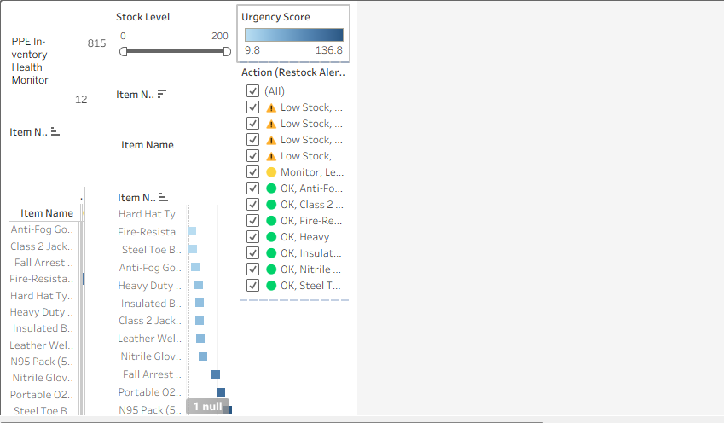

Slide 3
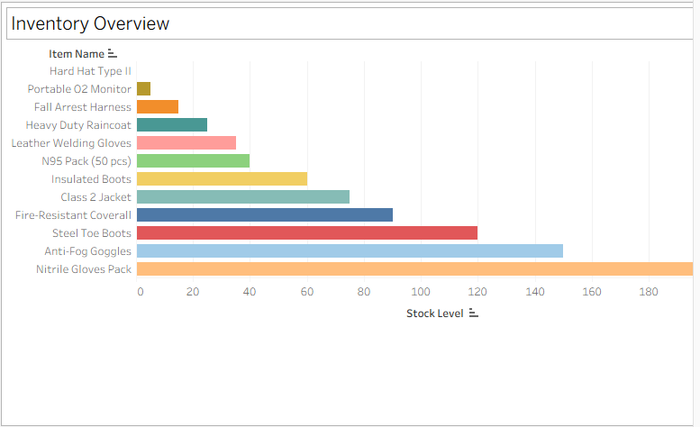

Slide 4
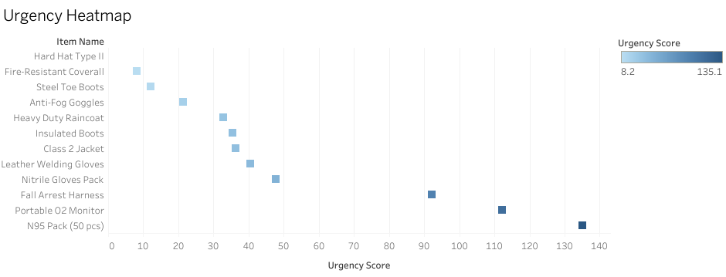

Slide 5
